Slide 1
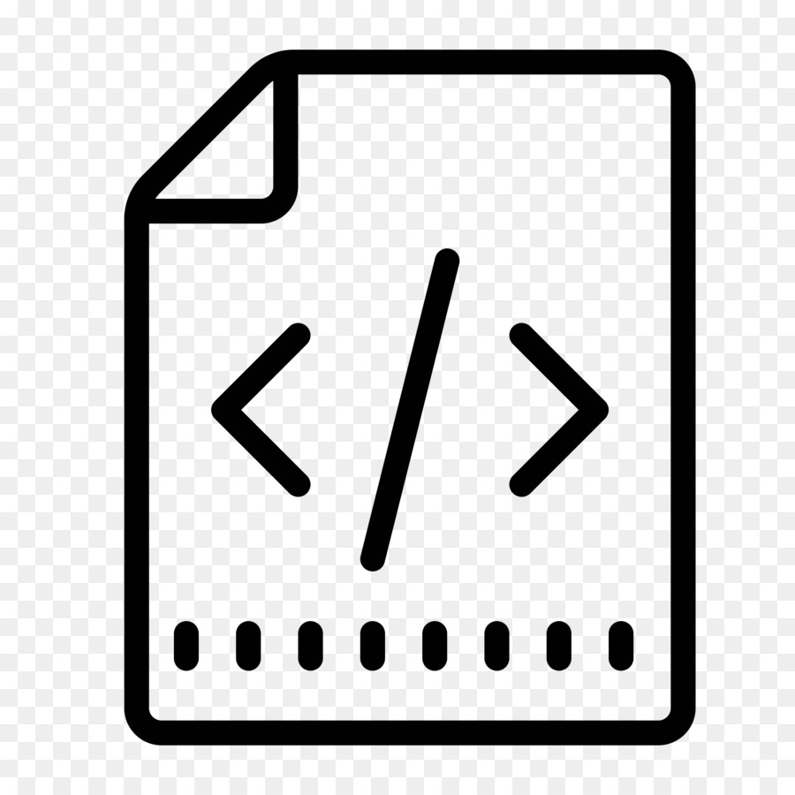


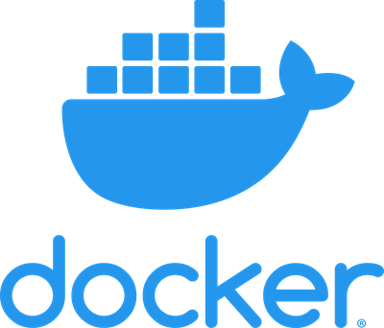
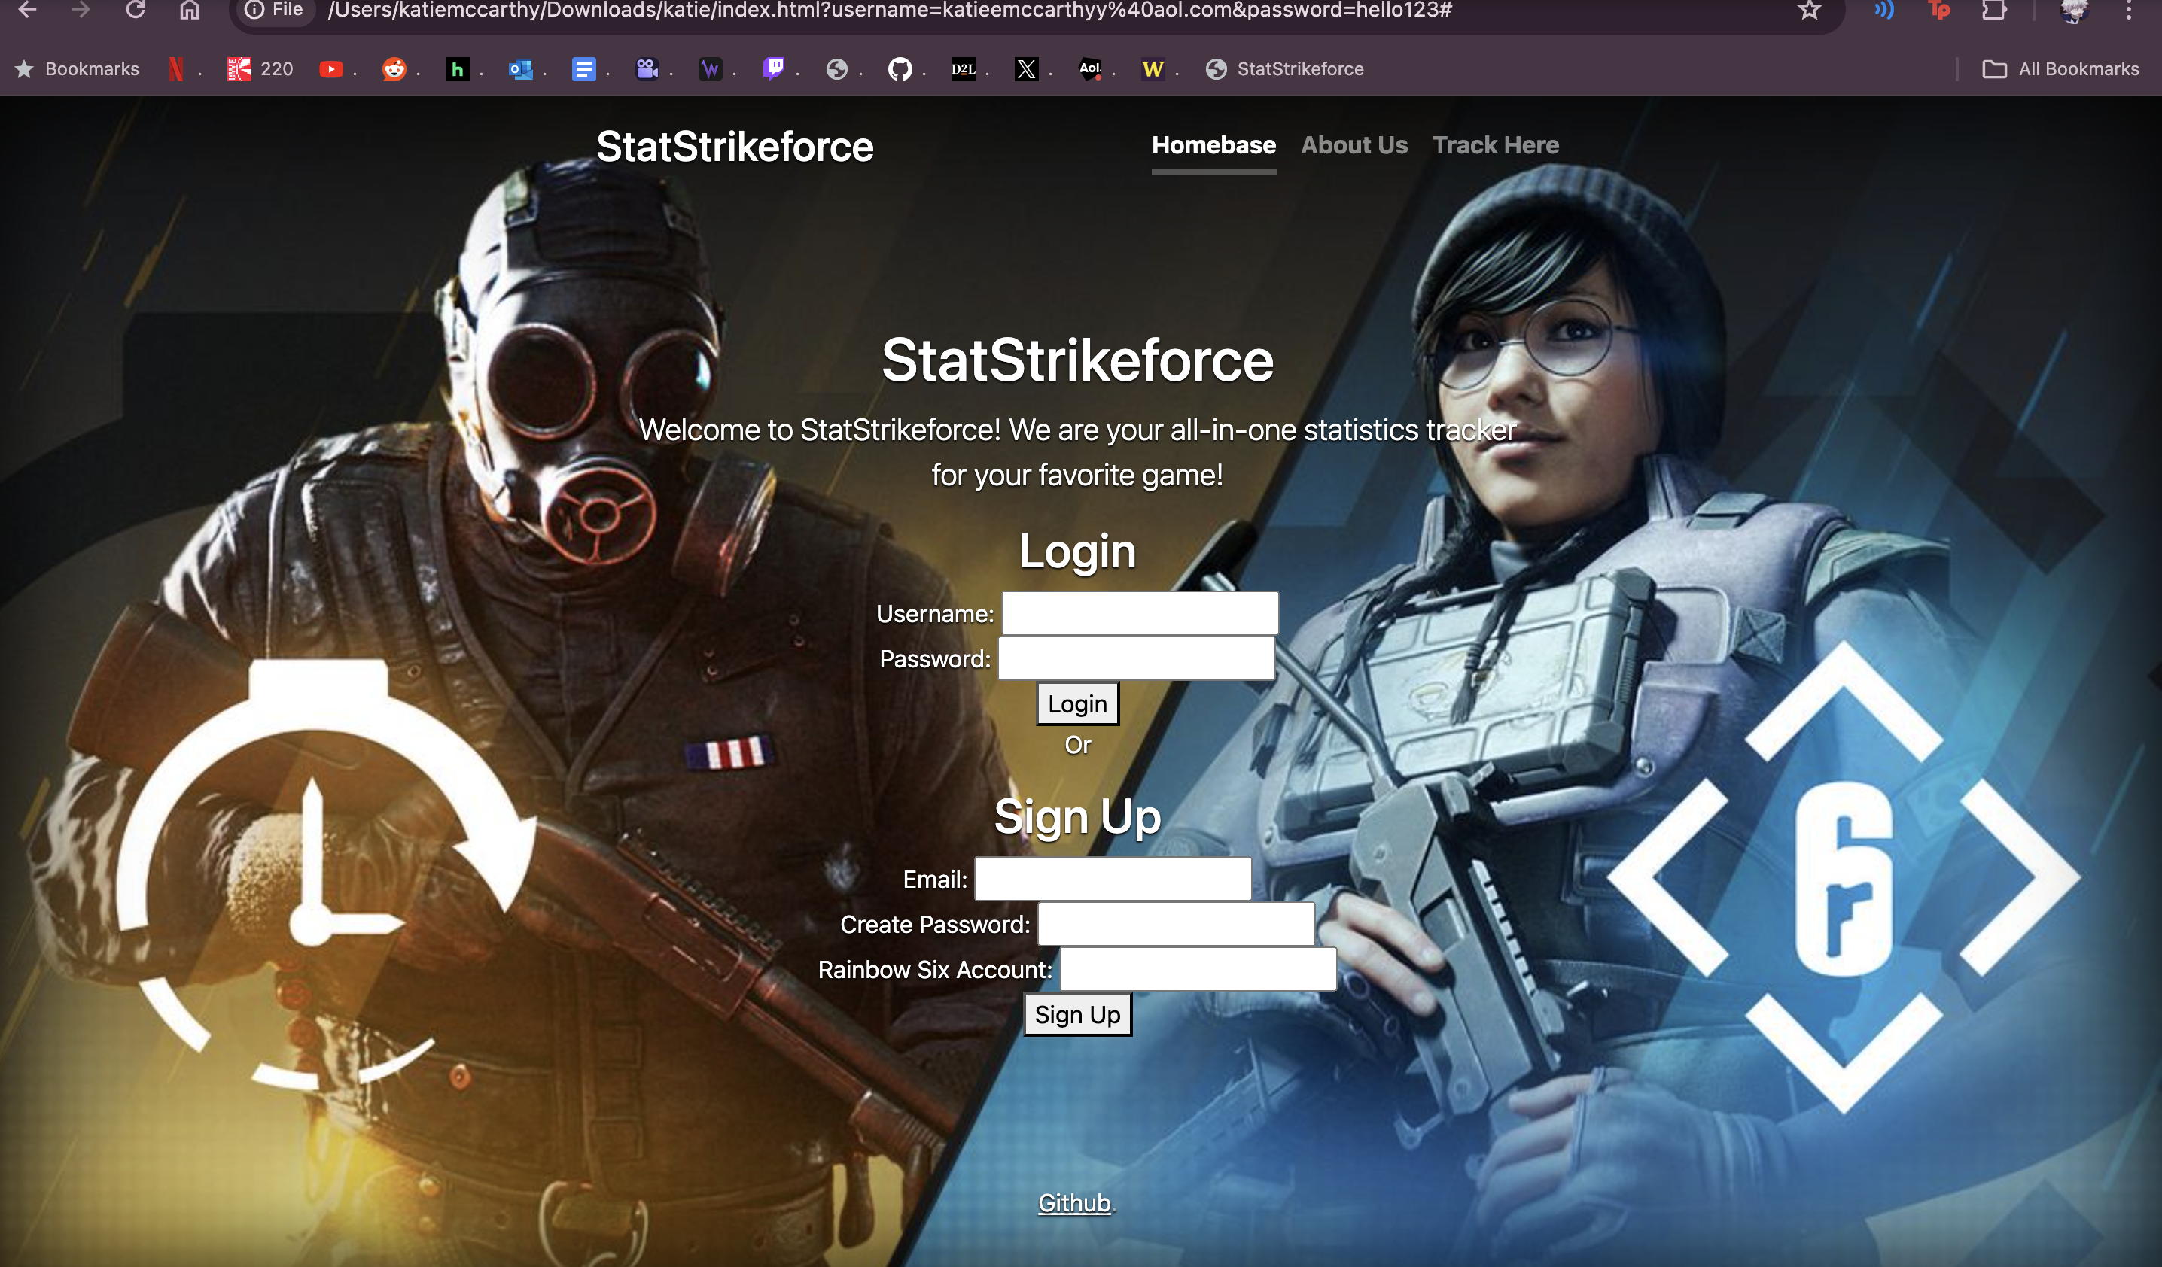
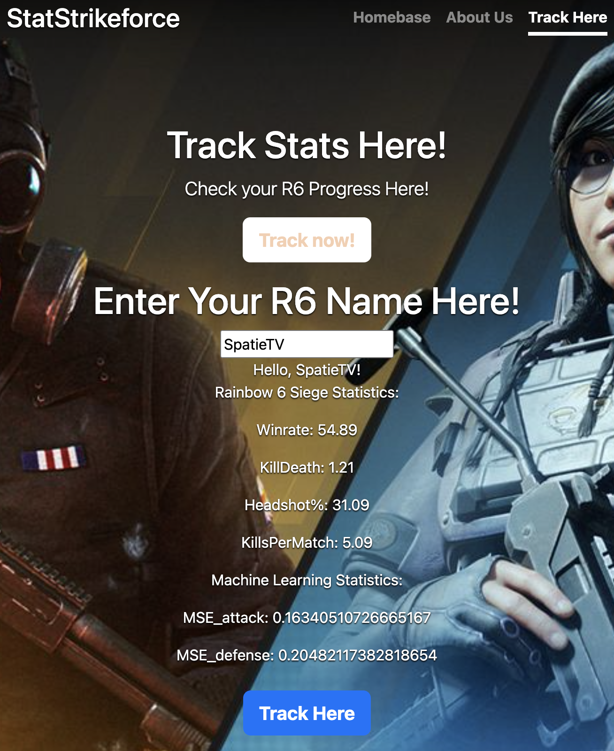
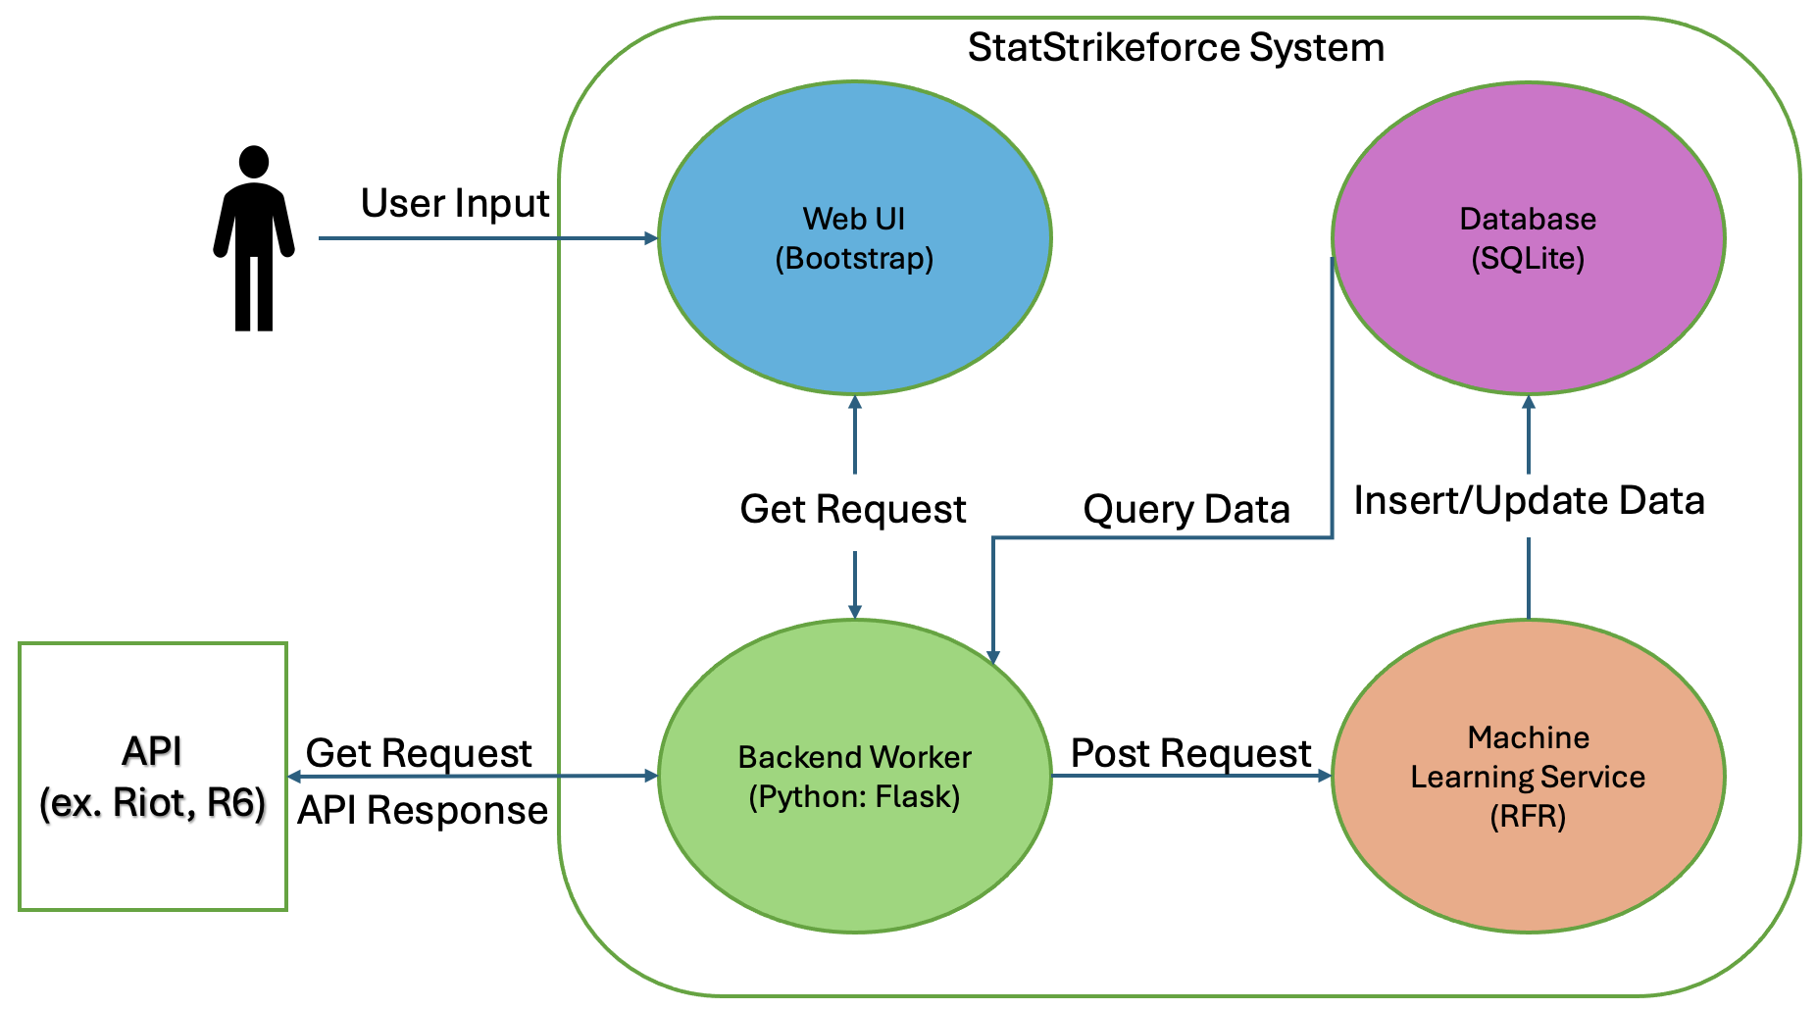
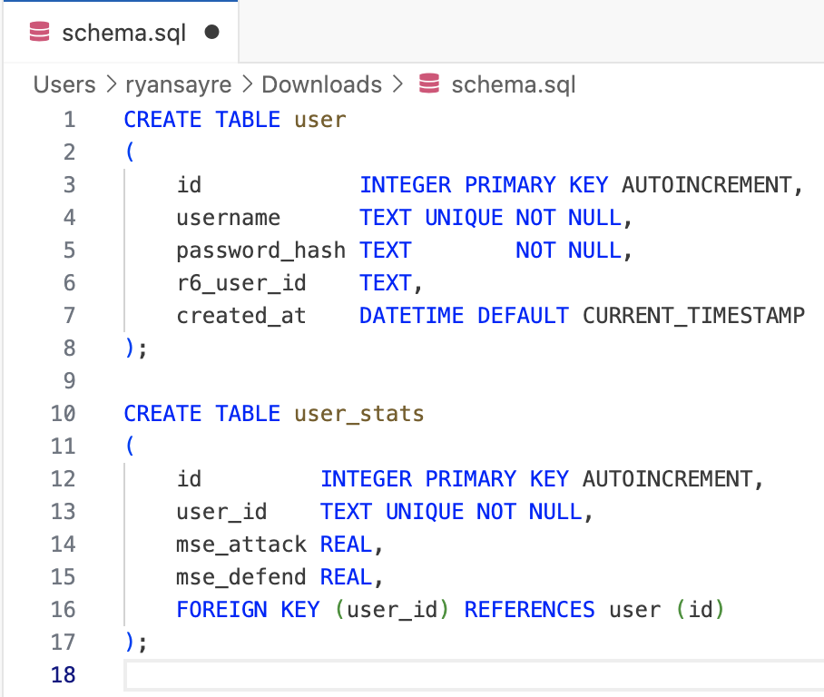
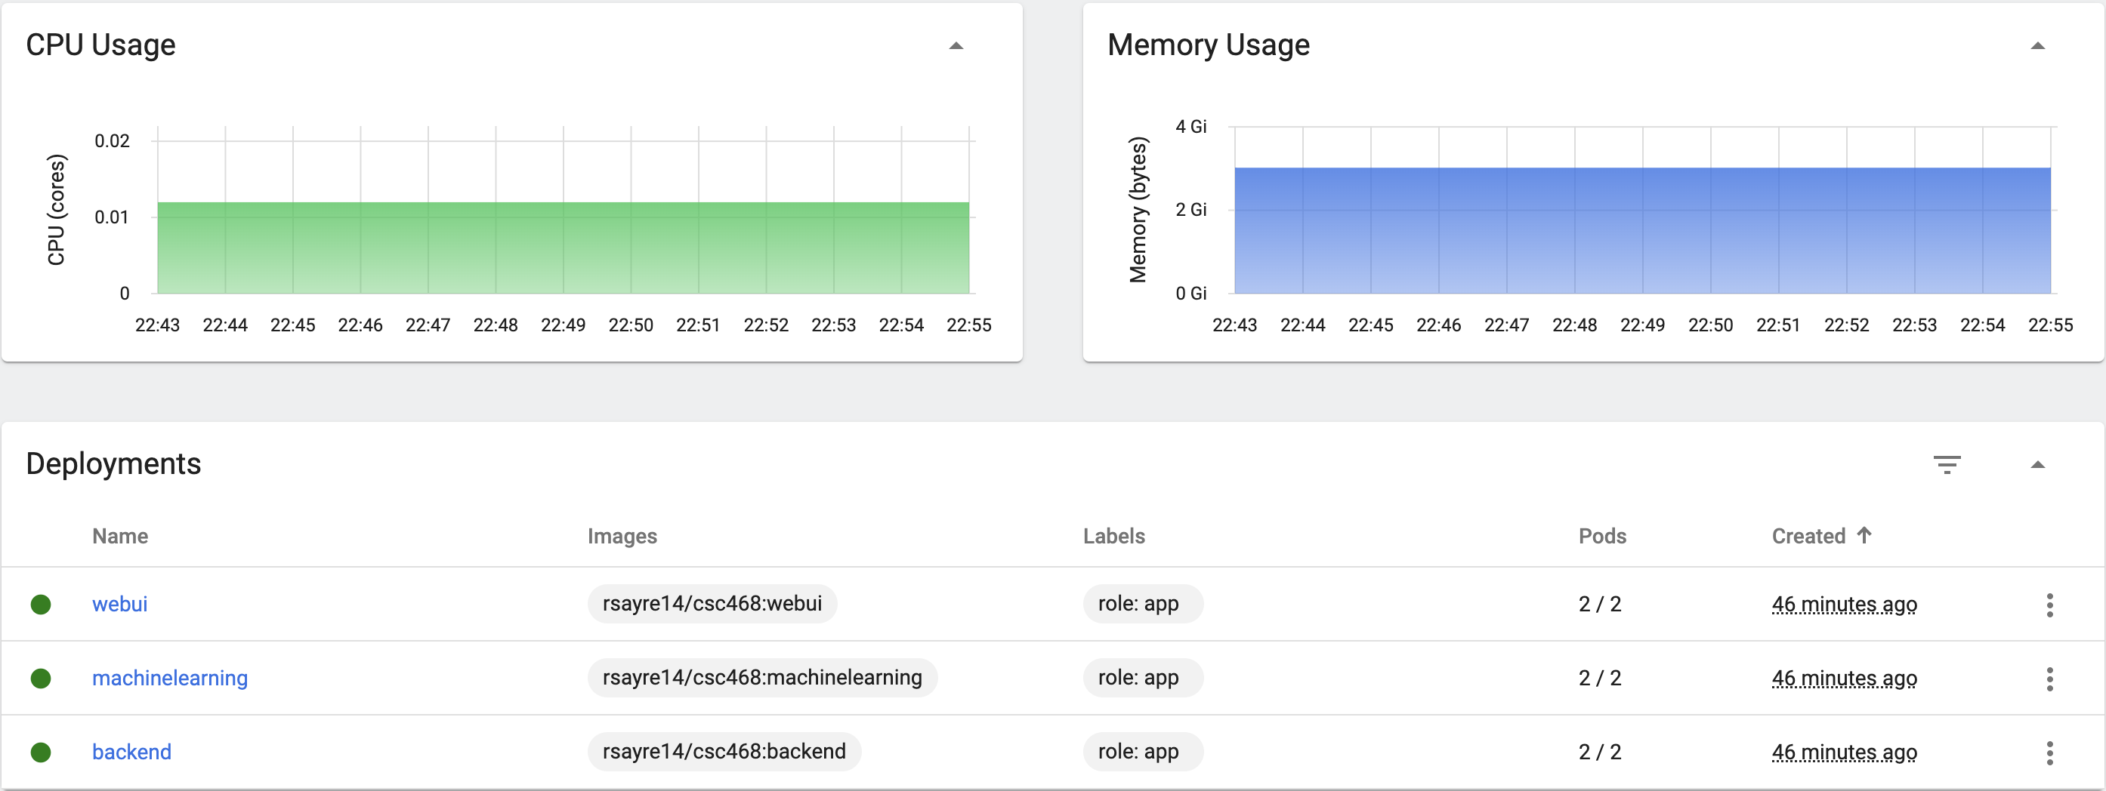
STATSTRIKEFORCE
Commit Code
Katherine McCarthy, Maxwell Mendenhall Ryan Sayre, Tobyn Sitar
PROJECT OVERVIEW
StatStrikeforce is a cloud-base web application, designed to reinvent the way you track your favorite video game statistics. The application allows for users to track their headshot percentage, Kill/Death ratio, win rate, and many other useful statistics with ease. StatStrikeforce gives players a competitive edge through its prediction feature, which uses machine learning to predict a player's performance and probability of a win in future matches based on recent match performance.
Deployment Update
Build
Images
Pull Images
Web UI
The website features three sections:
Homebase: Create or Login to account
About Us: Team member Descriptions
Track Here: Auto search for player stats
Uses Bootstrap, HTML, CSS, and JavaScript
Login Page
Stats Page
Concept Architecture
The backend worker will communicate with the front end via GET requests.
Then backend will communicate with the Rainbow Six API to get user info.
POST requests will be sent to the Machine Learning service.
ML service will then query the data into the database, with the primary key being UserID.
Each UserID will have corresponding prediction values made with the user data from the API.
Database Design
For our database design, we chose SQLite due to its space-saving capabilities and its compatibility with our backend through Python libraries, enabling efficient data storage and retrieval.
User Stats Table: Linked to the user via 'user_id', this table tracks game statistics. It uses the 'user_id' to connect user profiles performance from Rainbow Six Siege to their metrics in 'mse_attack' and 'mse_defend'
User Table: This table is for our login system. It stores the 'id' as the primary key along with 'username', 'password_hash' for secure authentication, and the 'r6_user_id'. The 'id' is unique to every user and auto-increments with new entries.
Cloud Deployment
Source code written and tested locally, before pushing to our project's GitHub repository.
GitHub will then trigger the build process to have Docker push updated images.
Kubernetes will pull images from DockerHub and run them in pods.
GitHub will also push a deployment update to Kubernetes directly.
Once the application is deployed, we can test functionality, monitor in dashboard, and plan for future builds.

